Slide 1


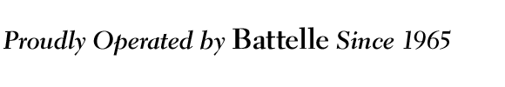
Making the Most of Uncertain
Low-Level Measurements
Presented to the Savannah River Chapter of the Health Physics Society
Aiken, South Carolina, 2011 April 15
Daniel J. Strom, Kevin E. Joyce, Jay A. MacLellan, David J. Watson, Timothy P. Lynch, Cheryl. L. Antonio, Alan Birchall, Kevin K. Anderson, Peter A. Zharov
Pacific Northwest National Laboratory
strom@pnl.gov +1 509 375 2626
PNNL-SA-75679
Notes:
Making the Most of Uncertain Low-Level Measurements
Strom DJ, KE Joyce, JA MacLellan, DJ Watson, TP Lynch, CL Antonio, A Birchall, and PA Zharov
Many measurement techniques in occupational and environmental monitoring produce results that have very substantial uncertainties. In many cases, a blank or background value must be subtracted from a gross result to produce a net result, a process that can produce non-physical, negative net results. When uncensored measurement results on a population are accompanied by well-characterized uncertainties, a novel method developed at PNNL separates the variance of the observations into two components, one arising from uncertainty and the other arising from population variability. Assuming the uncertain measurements are independent and unbiased, the method forces the arithmetic mean of the measurands (the “true values”) to equal that of the measurements. Further assuming that the measurands are lognormally distributed, the geometric mean and geometric standard deviation are calculated for a distribution of possibly true results. Assuming that the Bayesian prior probability density functions (PDF) of each individual measurement is a lognormal distribution comprised of every other measurand, posterior PDFs for each measurand are computed using Bayes’s theorem. The method corrects physically meaningless negative measurement results into PDFs of small positive values, but does little to alter large positive measurement results. Some surprising implications are illustrated by application to bioassay measurements of Sr-90, Cs-137, and Pu-239.
Abstract submitted to The 44th Annual Midyear Meeting of the Health Physics Society, Charleston, SC. PNNL-SA-75679.

Slide 2
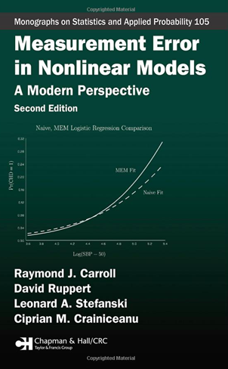

Prologue
Uncertainty is different for sets of sets of data than it is for single data points
If you have more than one uncertain measurement, you need to learn about measurement error models
HPs generally do not speak the language of statisticians well enough to be comprehended
  σ is not a synonym for standard deviation
  s is not σ is not
We have to get smarter!
  Or some biostatistician will commit regression calibration on our numbers!
Carroll RJ, D Ruppert, LA Stefanski, and CM Crainiceanu. 2006. Measurement Error in Nonlinear Models: A Modern Perspective. Chapman & Hall/CRC, Boca Raton.

Slide 3
Outline
Censoring
The lognormal distribution
Measurements and measurands
Requirements and assumptions for this novel method
Population variability and measurement uncertainty
Disaggregating the variance
Distribution of measurands
The “everybody” prior
3

Slide 4
Outline 2
Probability distributions for individual measurands
The Bayesian approach
The “everybody else” prior
Applications to real radiobioassay data
The importance of accurate uncertainty
Bohr’s correspondence principle
Conclusions
4

Slide 5
Censoring
Changing a measurement result
Common practices
  Set negative values to 0
  Set all results less than some value to
    0
    ½ the value
    The value
    A non-numeric character like “M”
Changing measurement results causes great problems in statistical inference
  DR Helsel. 2005. Nondetects and data analysis. Statistics for censored environmental data. John Wiley & Sons.
This method requires uncensored data
5

Slide 6
The Lognormal Distribution
Frequently observed in Nature
Multiplication of arbitrary distributions results in lognormals
  Ott WR. 1990. A Physical Explanation of the Lognormality of Pollutant Concentrations. J.Air Waste Mgt.Assoc. 40 (10):1378-1383
6

Slide 7
Measurand, Measurement, Error, and Uncertainty (ISO)
measurand: particular quantity subject to measurement
  also, the “true value of the quantity subject to measurement”
result of a measurement: value attributed to a measurand, obtained by measurement
error: the unknown difference between the measurand and the measurement
  this is a different meaning from the theoretical concept in statistics!
uncertainty: a quantitative estimate of the magnitude of the error
  statisticians often do not distinguish between error and uncertainty and may use them synonymously
7

Slide 8
Requirements and Assumptions
This method requires uncensored data
  small values are reported as they are calculated, with no rounding, setting negative values to zero, or otherwise changing
  Assume measurands are lognormally distributed
  Many populations in nature are lognormally distributed
  Lognormal common in radiological and environmental measurements
  Other functions could be used as long as they have a mean
8

Slide 9
Population Variability and
Measurement Uncertainty
The sample variance of a set of measurements on a population arises from two sources:
  population variability
  measurement error
If measurements have no error, then all observed sample variance is due to variability in the population
9

Slide 10
Measurement Error Model
True values (measurands) t_{i} give rise to measured values m_{i}
We have good independent estimates of the combined standard uncertainty u_{i} of each measurement m_{i}
m_{i} = t_{i} + u_{i}
u_{i} ~ N(0, u_{i}²)
We calculate the sample variance of m_{i}
We use sample variance and a summary measure of the u_{i} to estimate the variance due to population variability of t_{i}
10

Slide 11
Spread of Measurement Results
(Sample Variance) Is Due to 2 Causes
“Average” Measurement Uncertainty
Observed Spread
Variability within Population
11

Slide 12
Spread of Measurement Results
(Sample Variance) Is Due to 2 Causes
u_{RMS}
Observed Spread
Variability within Population
12

Slide 13
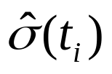
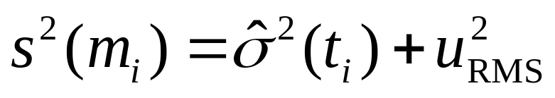
Spread of Measurement Results
(Sample Variance) Is Due to 2 Causes
u_{RMS}
s(m_{i})
θ
13

Slide 14
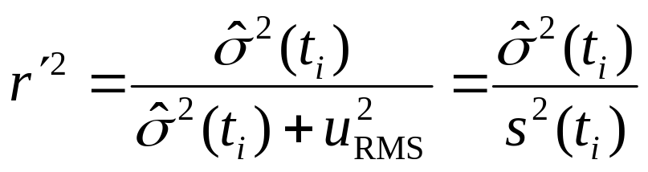
Estimating the
Variance of the Distribution of Measurands
The “reliability” or “attenuation” or “variability fraction” is
Analogous to a correlation coefficient
  r²: fraction of variance explained by model
  r′ ²: fraction of variance due to measurand variability
Estimated Variance of the Measurands
Sample Variance
of the Measurements
Mean Square Measurement Uncertainty
☑ Calculated
☑ Known
☑ Known

Slide 15
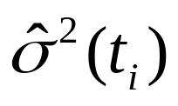
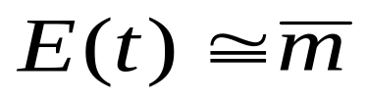
Distribution of Measurands
The estimated variance of the measurands is
Assume measurands are lognormally distributed
Assume the expectation of the measurands equals the mean of the measurements:
  measurements are unbiased
  this assumption respects the data
Calculate the parameters of the lognormal
  geometric mean
  geometric standard deviation s_{G}
This is the distribution of “possibly true values”
15

Slide 16
Analysis of Baseline Radiobioassay Data
⁹⁰Sr: 128 baseline urine bioassays
  Everyone is exposed to global fallout
  gas proportional counter
  100-minute counts
¹³⁷Cs: 5,337 baseline in vivo bioassays
  Everyone is exposed to global fallout & Chernobyl
  coaxial high-purity germanium (HPGe) scanning system
  10-minute scans
²³⁹⁺²⁴⁰Pu: 3,270 baseline urine bioassays
  All exposure is occupational; essentially no environmental exposure in North America
  α-spectrometry
  ~2,520 minute counts
16

Slide 17
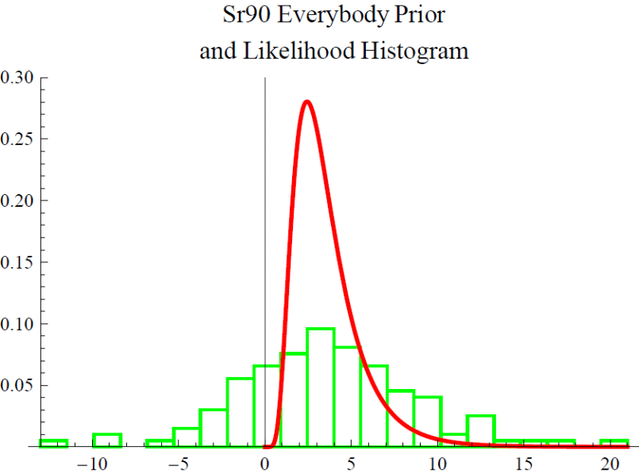
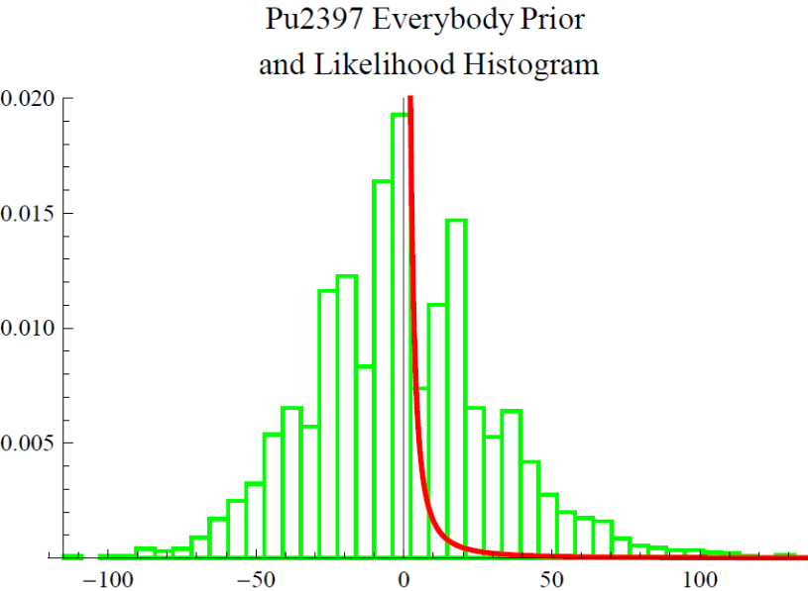
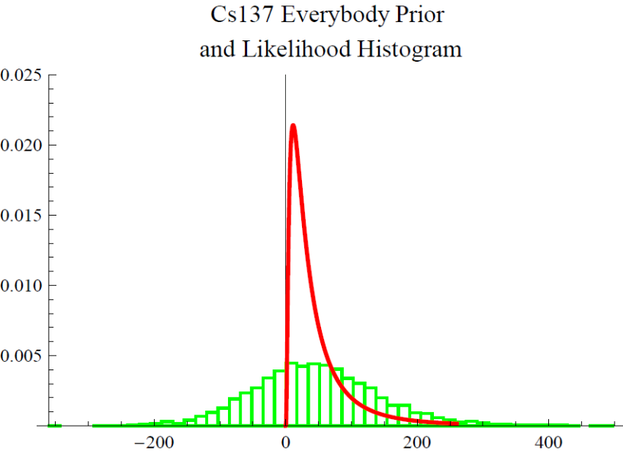
The “Everybody” Probability Density Function (PDF):
A Distribution of Possibly True Values
PDF of measurands
Histogram of data
probability density
Histogram and PDF have identical arithmetic means
⁹⁰Sr (mBq/day)
probability density
probability density
²³⁹Pu (µBq/sample)
¹³⁷Cs (mBq/kg)

Slide 18
Probability Distributions for Individual Measurands
Now that we have the lognormal PDF of all measurands, what can we say about individual measurands?
Each individual’s measurand is somewhere within the population of measurands
We now assume that each m_{i}, u_{i} pair is the mean and standard deviation of the Normal “likelihood” PDF for individual i
Assume the i^{th} measurement was the last one made in the population
  When the i^{th} measurement was made, the other M−1 m and u values were known
Use this with Bayes’s theorem
18

Slide 19
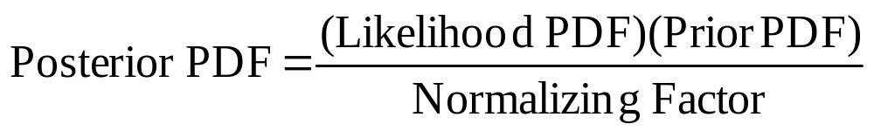
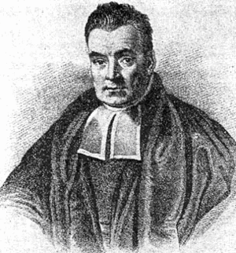
The Bayesian Approach to Assigning Possibly True Results to Individuals
Thomas Bayes 1702 – 1761
19

Slide 20
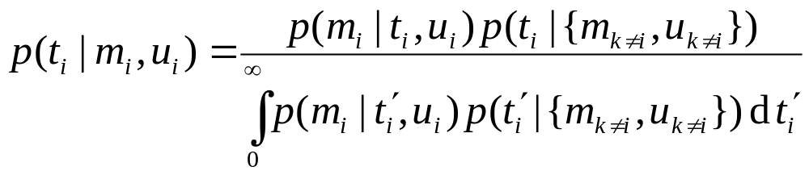
Bayesian Method for Individuals
Instead of the “everybody” PDF, the “everybody else” PDF is used as the prior for each individual
Each individual’s likelihood is a normal distribution with mean m_{i} and standard deviation u_{i}
Using Bayes’s theorem, we developed a method to derive a posterior probability density function (PDF) for each individual’s measurand t_{i}
20

Slide 21
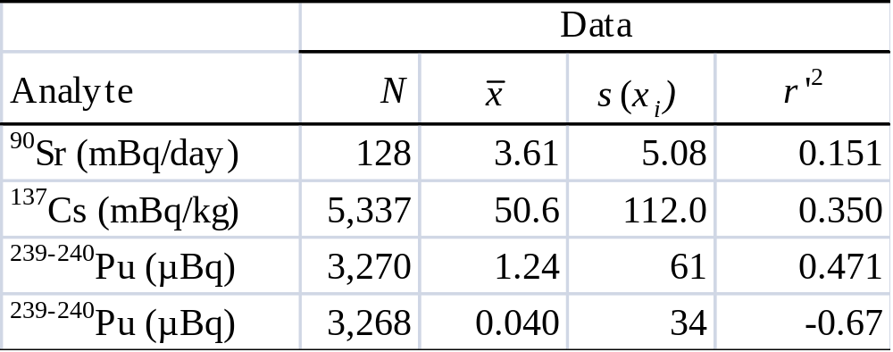

Applications to Real Radiobioassay Data
s(x_{i})
Impossible!
For Pu measurements, either the uncertainties u_{i} are overestimated, or a covariance term has been neglected.
21

Slide 22
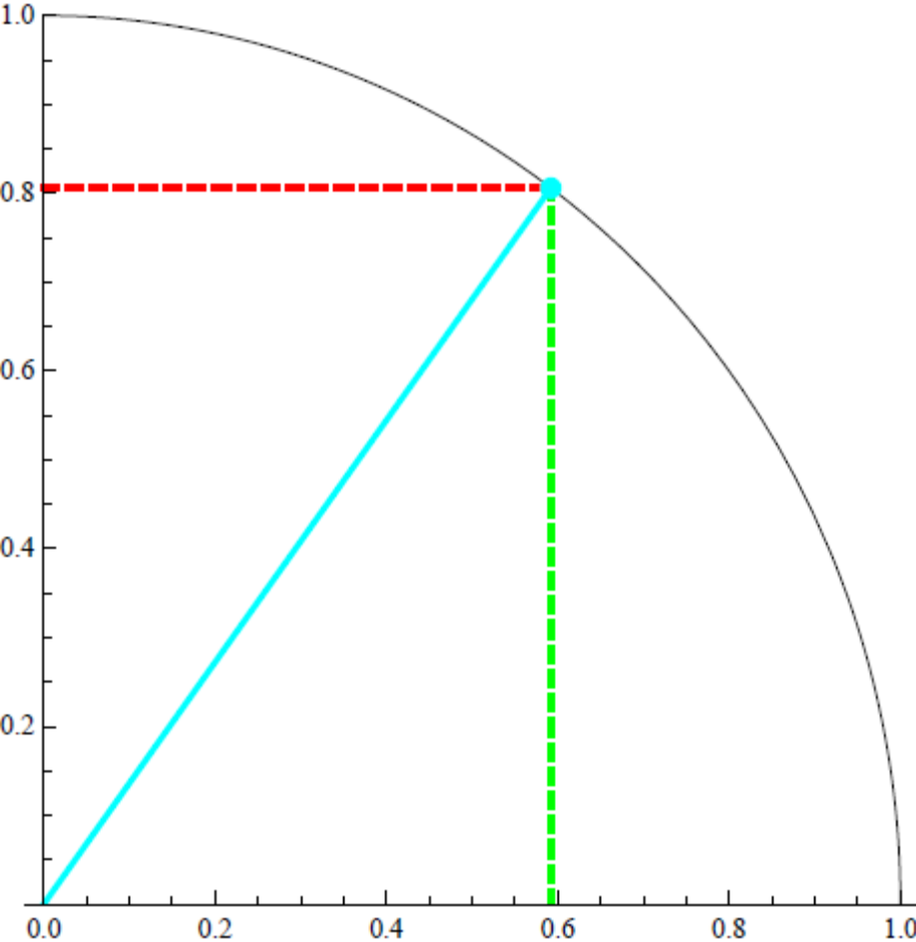
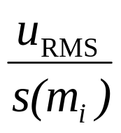
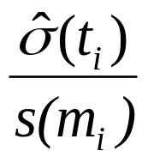
Variability Fractions r′²
¹³⁷Cs
¹³⁷Cs
r´²=0.35

Slide 23
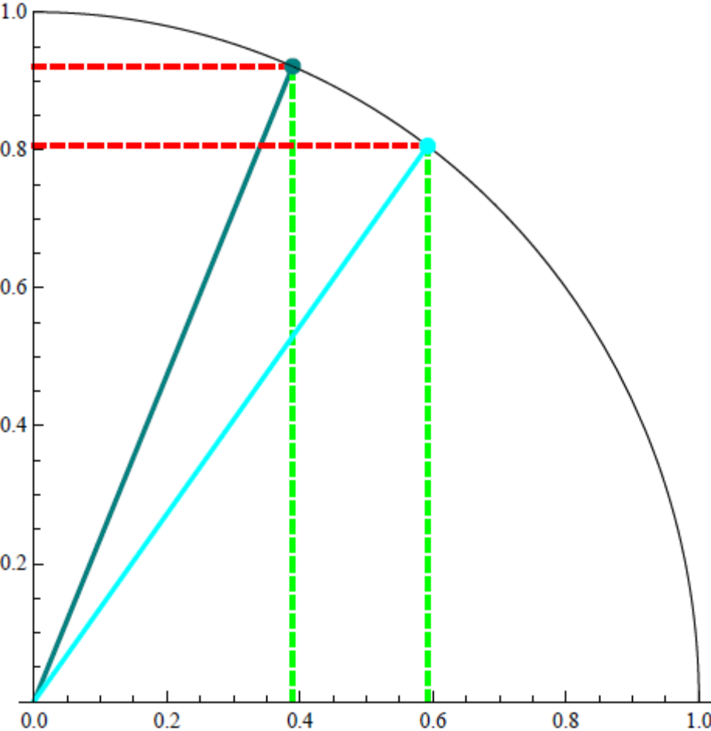
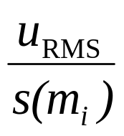
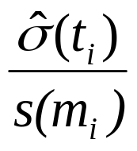
Variability Fractions r′²
⁹⁰Sr
¹³⁷Cs
⁹⁰Sr
r´²=0.15
¹³⁷Cs
r´²=0.35

Slide 24
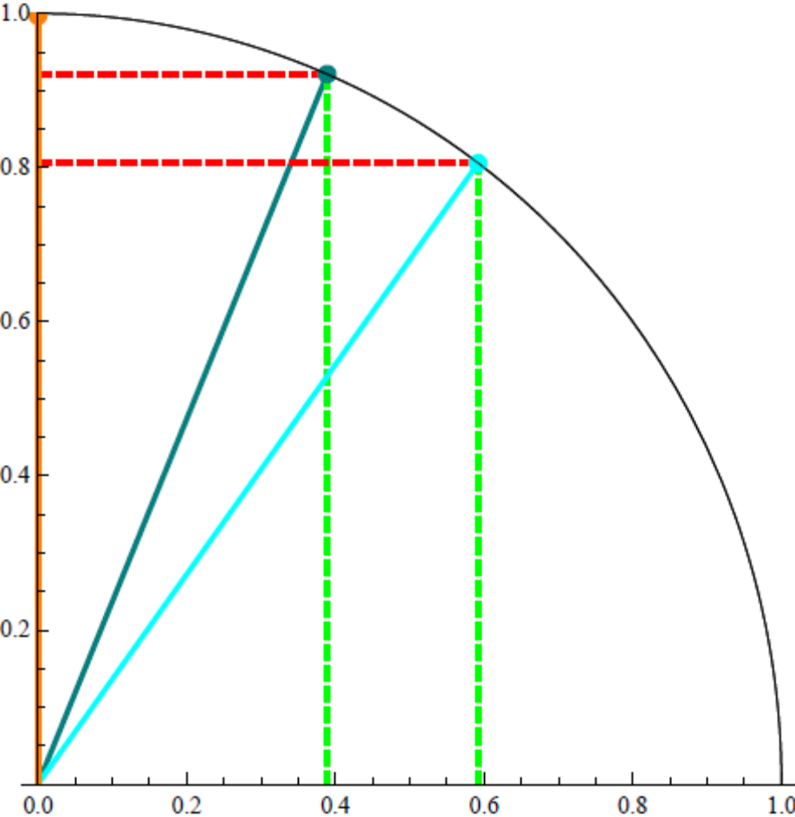
Variability Fractions r′²
²³⁹Pu
⁹⁰Sr
¹³⁷Cs
²³⁹Pu
r´²~0
⁹⁰Sr
r´²=0.15
¹³⁷Cs
r´²=0.35

Slide 25
⁹⁰Sr Results for 4 Individuals
Uncensored Data Are Critical!
Negative Result
Measurand
Result ≈ 0
Measurement
Likelihood PDF
Prior
Result ≈ Average
Result = Large Positive
25

Slide 26
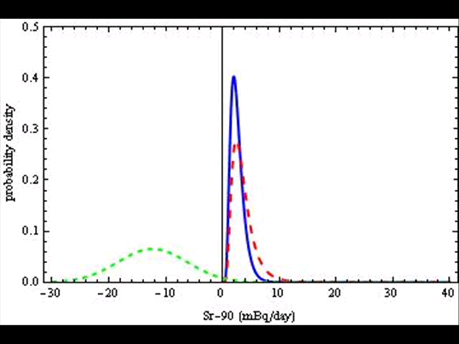
A Movie of 128 ⁹⁰Sr Results
Short Dashes (Green): Likelihood (Data)
Long Dashes (Red): Everybody Else Prior
Solid (Blue): Posterior

Slide 27
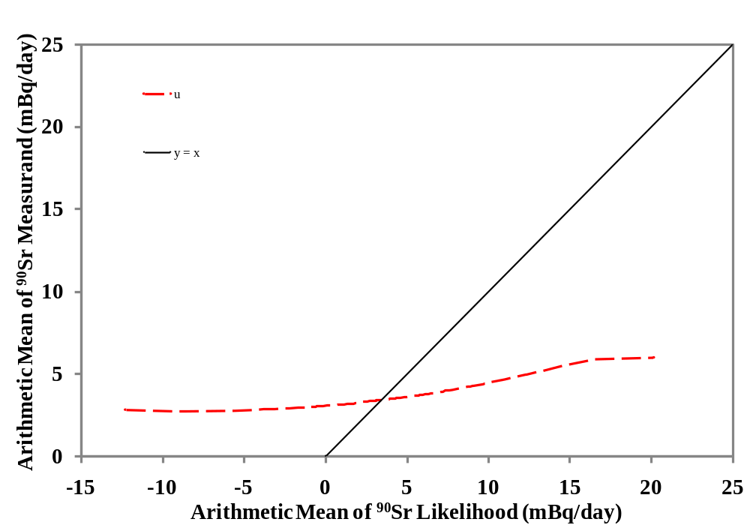
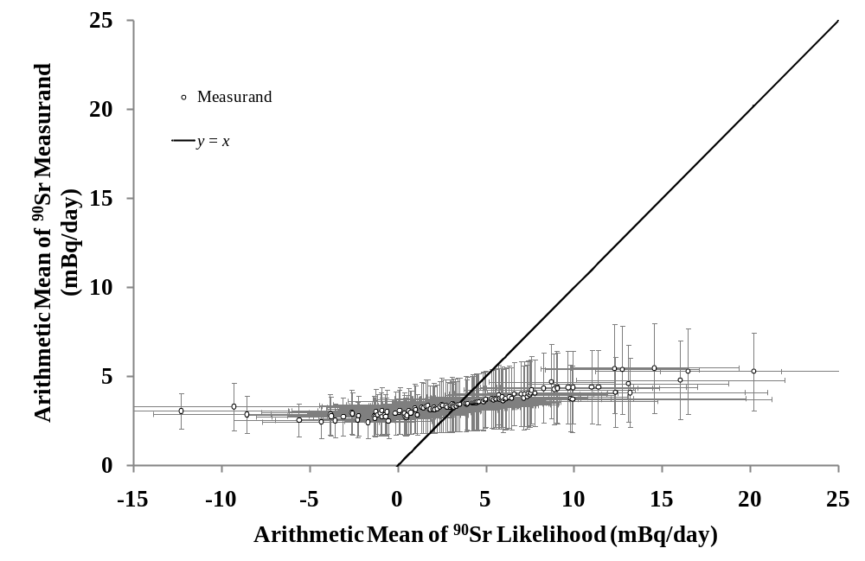
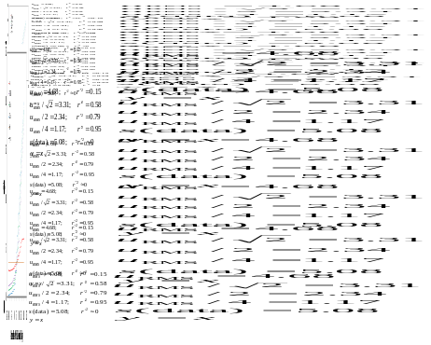
⁹⁰Sr Measurands v Measurements

Slide 28
⁹⁰Sr Measurands v Measurements
Assigned Uncertainty

Slide 29
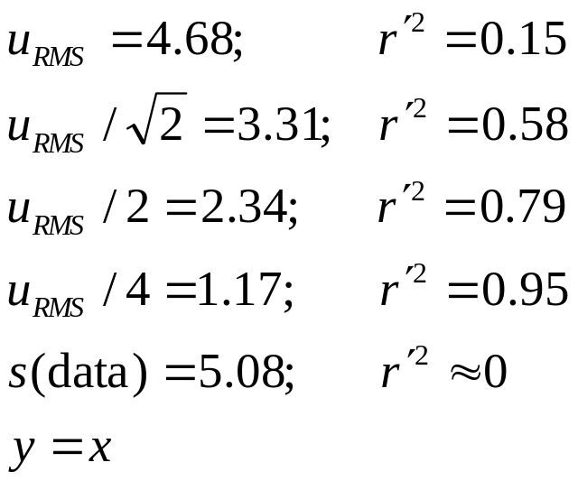
Effect of Reducing Uncertainty
Assigned Uncertainty
29
29
29

Slide 30
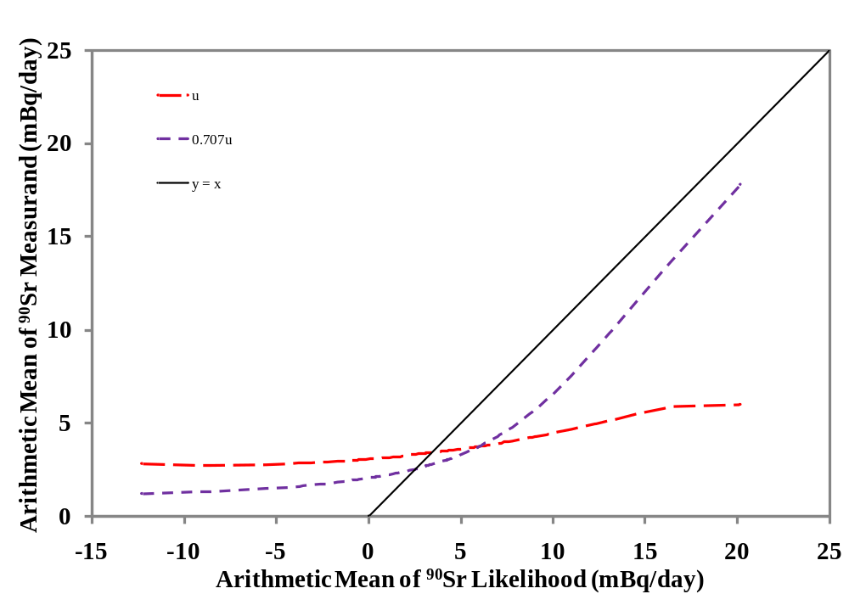
Effect of Reducing Uncertainty
Assigned Uncertainty
30
30
30
30

Slide 31
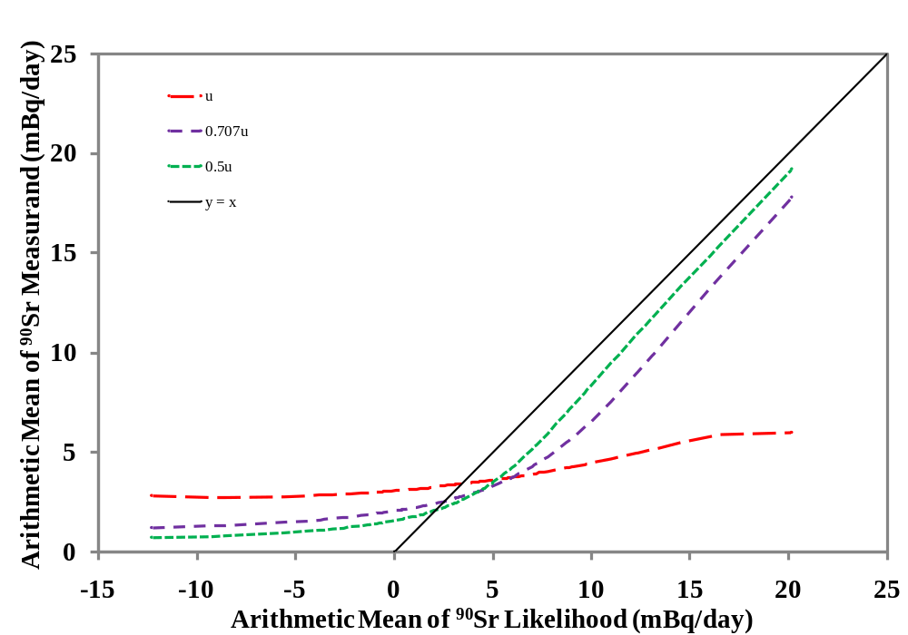
Effect of Reducing Uncertainty
Assigned Uncertainty
31
31
31
31
31

Slide 32
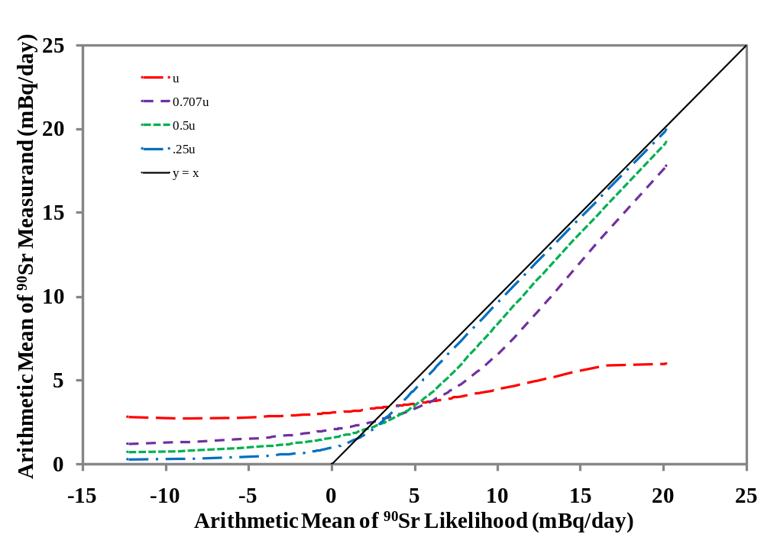
Effect of Reducing Uncertainty
Assigned Uncertainty
32
32
32
32
32

Slide 33
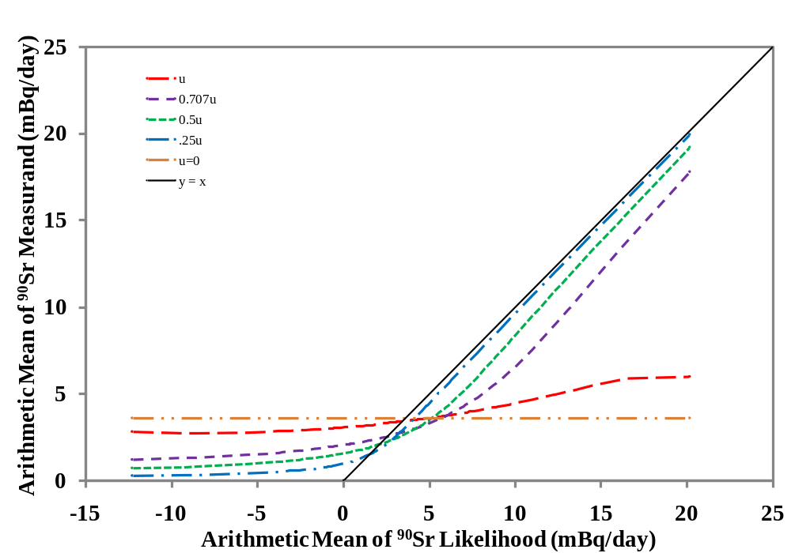
Effect of Reducing Uncertainty
Assigned Uncertainty
33
33
33
33
33
33

Slide 34
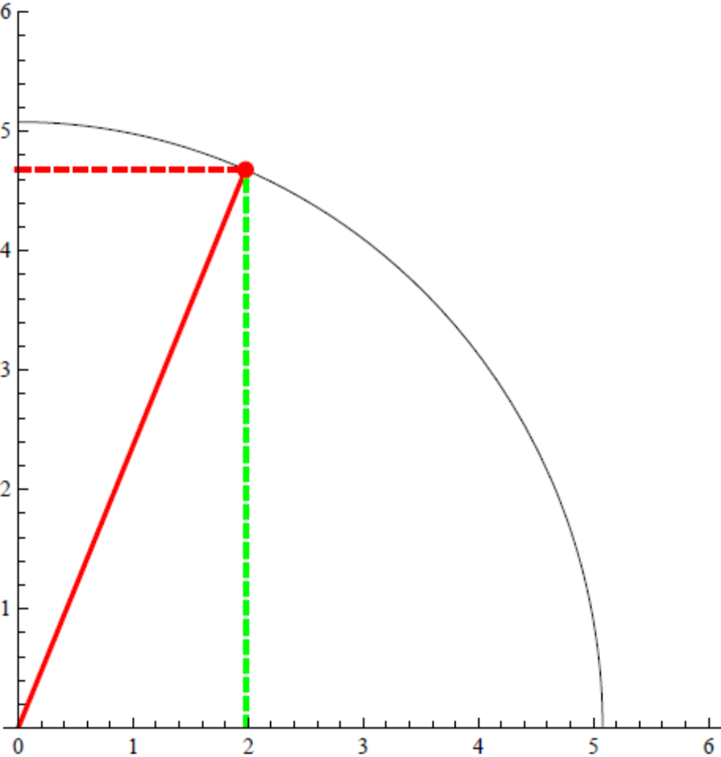
Visualizing Uncertainty Reduction
u_{RMS}
r´² = 0.15
‹
σ(ν_{i})

Slide 35
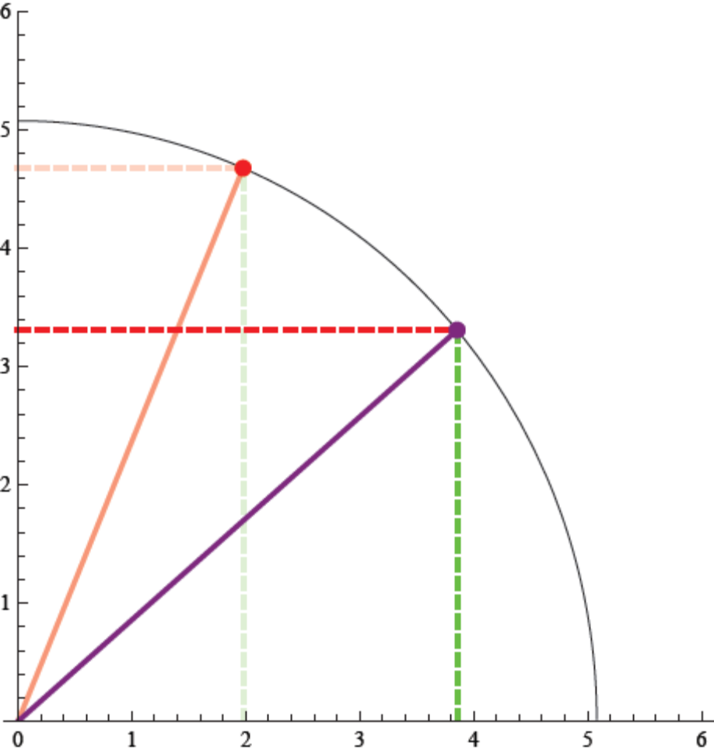
Visualizing Uncertainty Reduction
u_{RMS}
r´² = 0.15
r´² = 0.57
‹
σ(ν_{i})

Slide 36
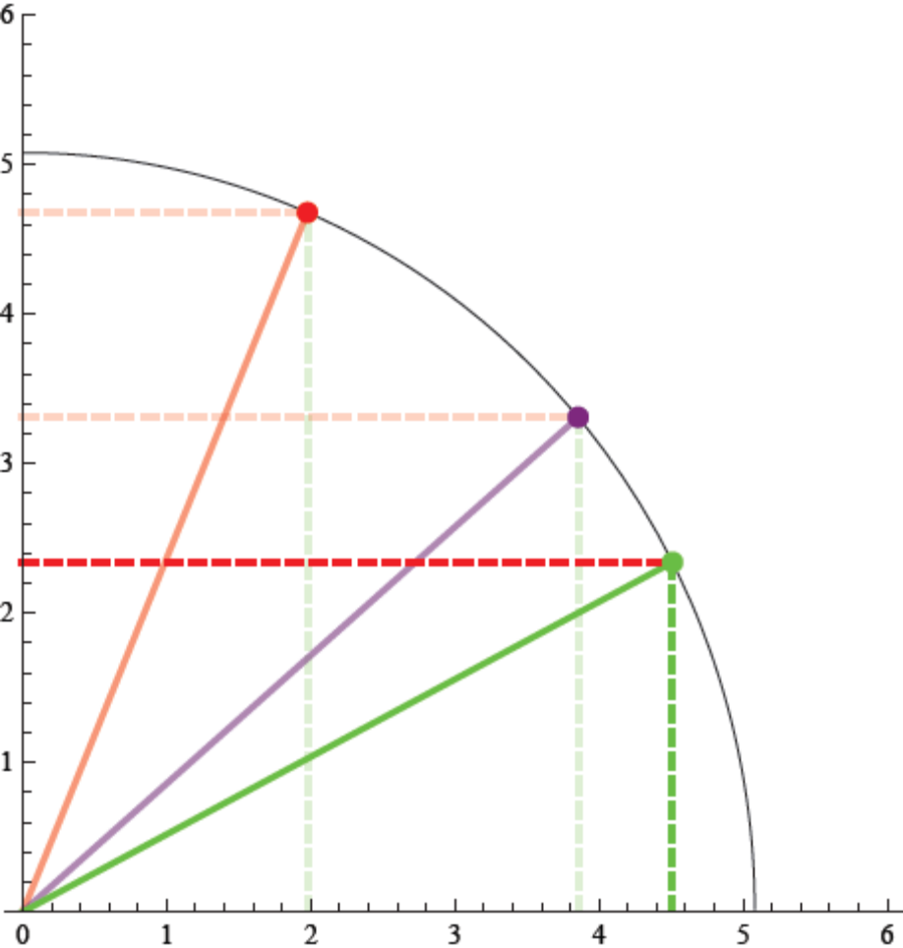
Visualizing Uncertainty Reduction
u_{RMS}
r´² = 0.15
r´² = 0.57
r´² = 0.78
‹
σ(ν_{i})

Slide 37
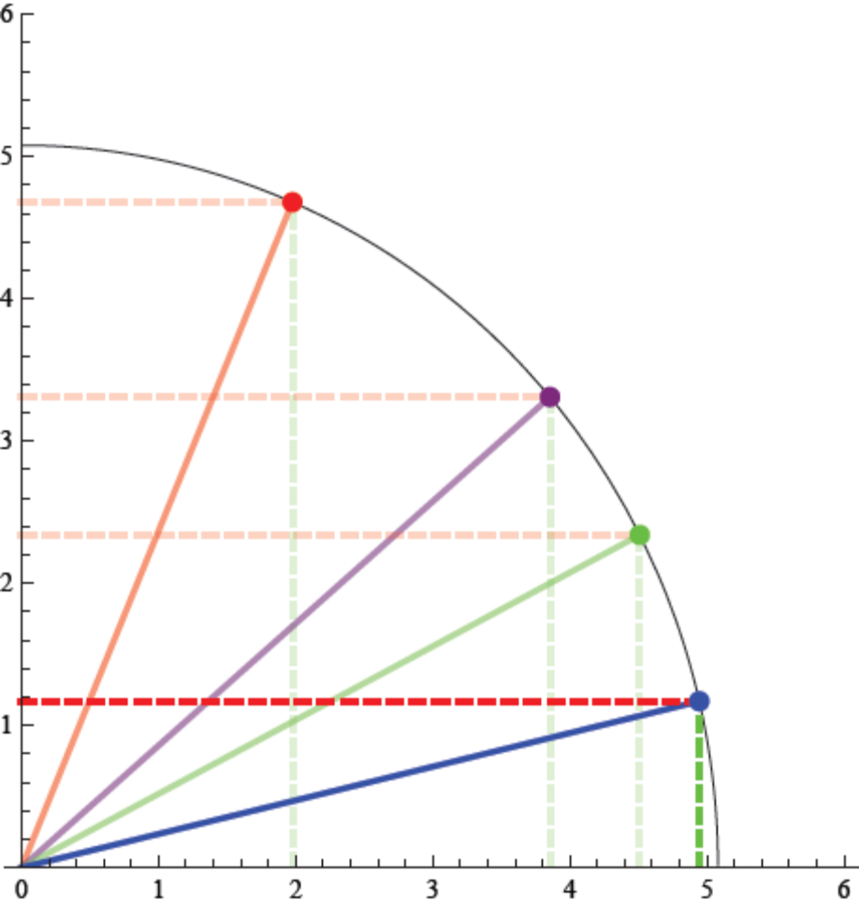
Visualizing Uncertainty Reduction
u_{RMS}
r´² = 0.15
r´² = 0.57
r´² = 0.78
r´² = 0.94
‹
σ(ν_{i})

Slide 38
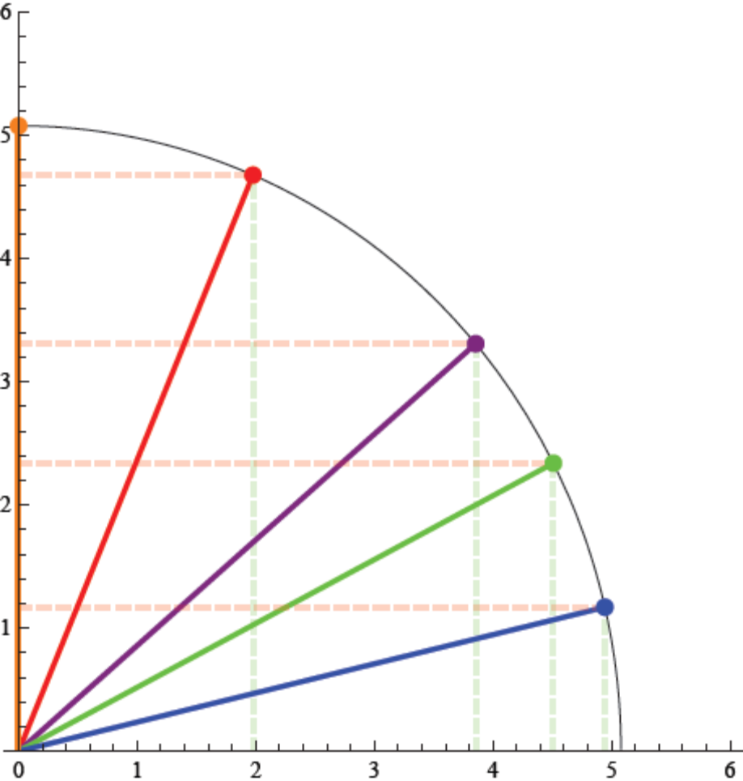
Visualizing Uncertainty Reduction
u_{RMS}
r´² ≈ 0
r´² = 0.15
r´² = 0.57
r´² = 0.78
r´² = 0.94
‹
σ(ν_{i})

Slide 39
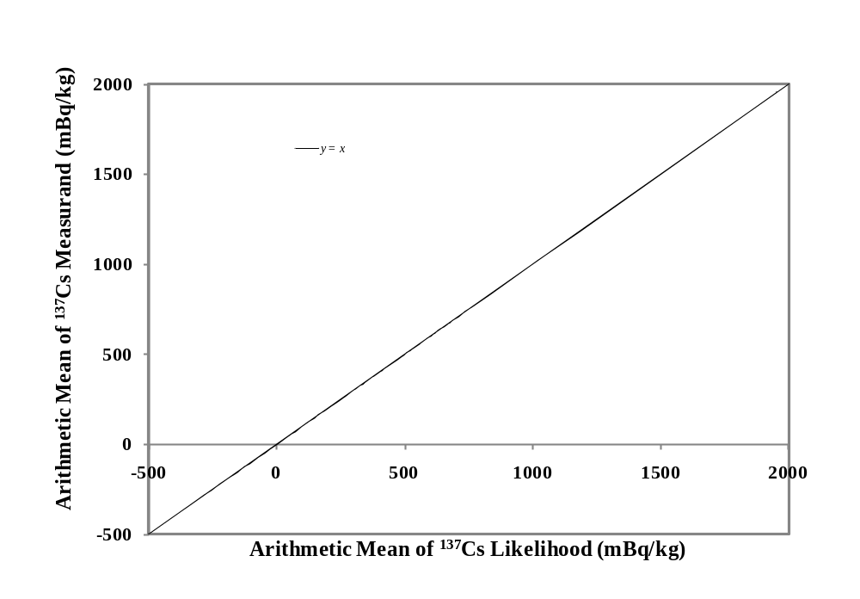

The Common View:
The Measurement Is the Measurand
Oh, no! Results are
below some level
(DL, DT, LOD, etc.).
Might not be real!
Tilt
Oops! Activity < 0 is meaningless.

Slide 40
The Bayesian View: The Measurement
and the Prior Give the Measurand

Slide 41
The Bayesian View: The Measurement
and the Prior Give the Measurand

Slide 64
The Bayesian View: The Measurement
and the Prior Give the Measurand

Slide 65
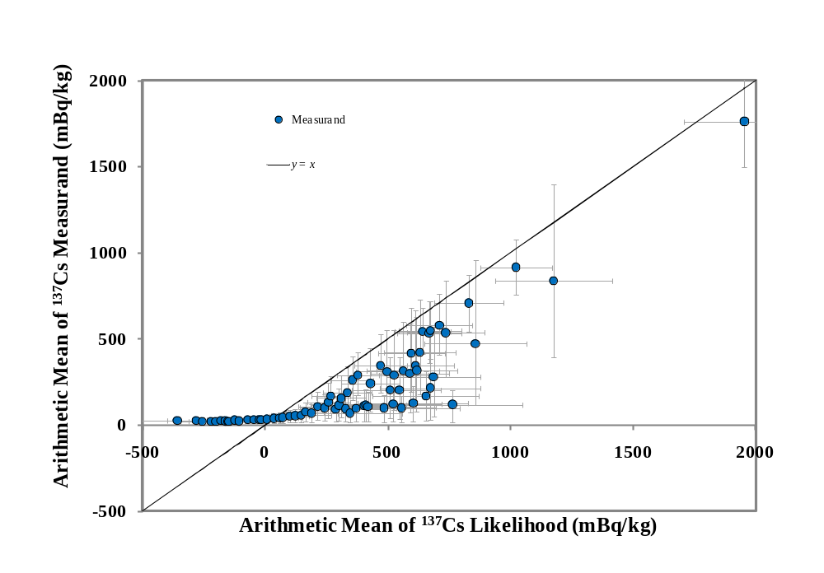
5,337 ¹³⁷Cs Measurements Showing Uncertainty in Measurements & Measurands

Slide 66
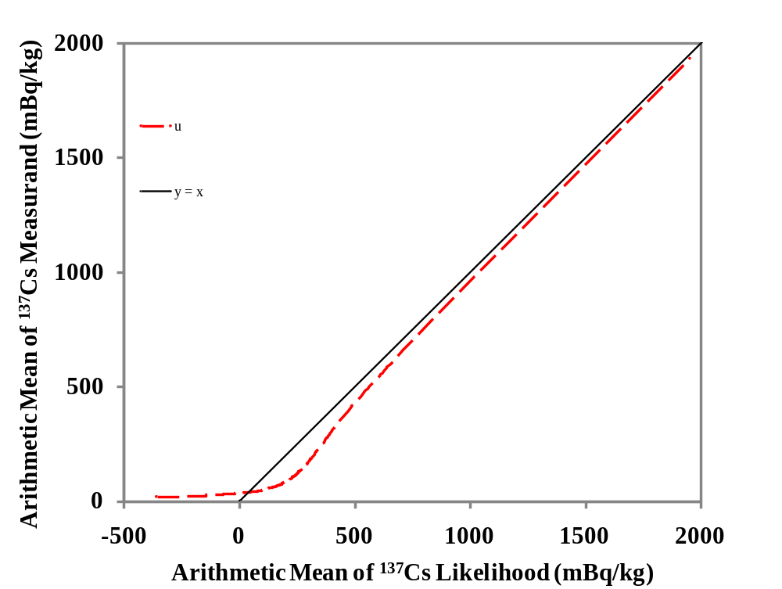
5,337 ¹³⁷Cs Results with Same Uncertainty
Assigned Uncertainty

Slide 67
5,331 ¹³⁷Cs Results
Assigned Uncertainty

Slide 68
The Importance of Accurate Uncertainty
Upper (red) point
everybody else prior
likelihood (data)
posterior (measurand)
Nearly the same measurement result
s(lower) ≈ 2.5s(upper)
Upper posterior resembles likelihood (i.e., measurement)
Lower posterior resembles prior
Lower (yellow) point
everybody else prior
posterior (measurand)
likelihood (data)
68

Slide 69
5,331 ¹³⁷Cs Results

Slide 70
5,331 ¹³⁷Cs Results – Log Scale
Assigned Uncertainty

Slide 71
Innovation 1
this work addresses the situation in which each measurement is accompanied by a very good estimate of its uncertainty
  not described in the literature reviewed
  which occurs routinely in radiochemical and radiobioassay measurements
71

Slide 72
Innovation 2
This work provides a solution to the vexing problem of making sense of negative measurement results for a quantity, such as activity in becquerels, which physically must be nonnegative
  none of the literature addresses negative values
The method makes sense of uncertain low-level measurements
  without injecting a bias into the dataset by left-censoring
  by implicitly recognizing that spurious negative results are accompanied by an equal amount of spurious positive signal
72

Slide 73
Innovation 3
This work provides posterior estimates, in the form of probability distributions, of the true value of each measurand
  while the literature is concerned with correcting estimates of slopes of dose-response relationships for the effects of classical measurement error
73

Slide 74
Innovation 4
This work shows that accurate estimates of uncertainty are as important as the values of the measurement results
  overestimates of uncertainty can lead to nonsense results
74

Slide 75
Innovation 5
This work provides the ability to explore the impact of the magnitude of uncertainty on the posterior distribution of measurands by thought experiments involving substitution of the mean square measurement uncertainty, or some multiple or submultiple of it, for the individual uncertainties
75

Slide 76
Innovation 6
The method is shown to closely correspond to classical (frequentist) methods when uncertainty is relatively small
76

Slide 77
Innovation 7
This work answers the questions, conditional on plausible assumptions,
  “What true state of nature gave rise to this set of observations?”
  “For each individual measurement result, what are the probable values of the measurand that led to this measurement result?”
The authors believe that the method represents a significant step forward in the making sense of groups of uncertain, low-level radioactivity measurements
77

Slide 78

Conclusions
Sample variance of a set of measurements is disaggregated into
  measurement uncertainty
  population variability
A reasonable, possible distribution of measurands for a population is the result
When , positive posterior PDFs of the measurand are computed using “everybody else” priors for each individual
  negative values are eliminated
  mean of measurements is preserved
When there is essentially no variance in the data due to population variability, the method cannot be expected to work, and it does not work
78

Slide 79
Conclusions: Utility and Correspondence
The method eliminates negative measurement results in an uncensored data set and preserves the arithmetic mean of the data set
  If measurement results have a relatively large uncertainty, the posterior PDF of the measurand resembles the prior
  If the measurement results have a relatively small uncertainty, the posterior PDF of the measurand resembles the likelihood, that is, it is relatively close to the measurement result before application of the Bayesian methods
Best estimate of uncertainty is just as important as measurement!
As required by Bohr’s correspondence principle, results produced by the methods introduced here correspond to results of traditional statistical inference in the domain in which that inference is known to be correct
79

Slide 80
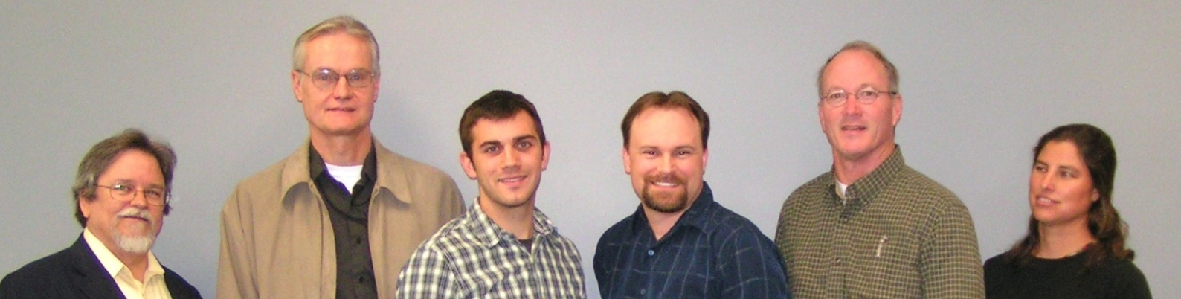
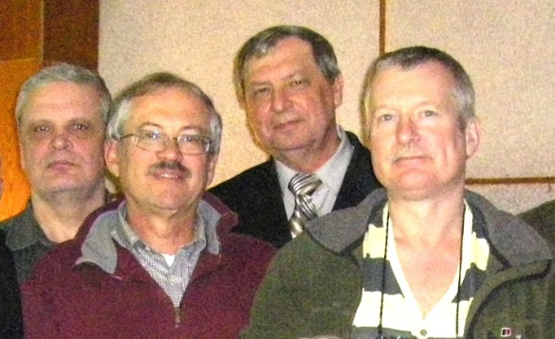
Authors
Strom MacLellan Joyce Watson Lynch Antonio Zharov Birchall
(Mayak PA) (UK HPA) (Scherpelz, Vasilenko)
Acknowledgments
PNNL: Kevin Anderson, Gene Carbaugh, Michelle Johnson, Bruce Napier, Bob Scherpelz, Paul Stansbury, Rick Traub
SUBI: Vadim Vostrotin

